Slide 1
Mass Spectrometry

Slide 2

Have you watched shows like NCIS and CSI, where routinely samples are taken back to the lab for analysis to catch the criminals?
In this Smart Lesson you will learn about the analytical technique used to do this, called mass spectrometry. You will learn that this technique involves the ionisation of substances and the separation and detection of the resulting ions. The spectra generated can be analysed to determine the isotopic composition of elements, and interpreted to determine relative atomic mass.
This technique can also be used to identify unknown compounds, determine structure of a compound or quantify the amounts of substances present in a sample.

Slide 3

There is a large range of situations in chemistry where knowing and communicating the level of purity of substances is extremely important. Impurities can affect the physical and chemical properties of substances, resulting in inefficient or unwanted chemical reactions.
Scientists use methods such as mass spectrometry to identify impurities and the level of contamination. Separation methods which improve the purity of substances are used for food, fuels, cosmetics, medical products and metals used in microelectronic devices. Scientific conventions and international standards are used to represent the purity of materials to ensure consistent applications of standards.
Analytical tools can also help identify unknown materials and even identify the gases that make up the stars!

Slide 4
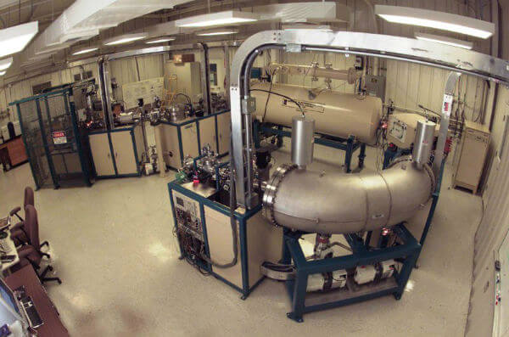
One analytical technique that can be used to determine the molecular mass and therefore the molecular formula of the unknown compound is mass spectrometry.
Accelerator mass spectrometer at Lawrence Livermore National Laboratory in California, USA.
3 of 37

Slide 5
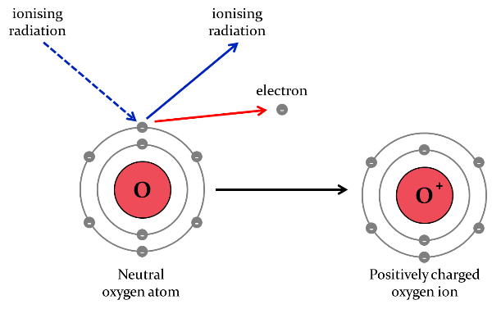
In the simplest terms, mass spectrometry involves ionising and fragmenting a compound and sorting the ions based on their mass to charge ratio. This provides a measure of the mass of the molecule and different fragments that make it up.
You don't need to know exactly how a mass spectrum is produced, but knowing the basic principle may help you to understand what you are looking at.

Slide 6
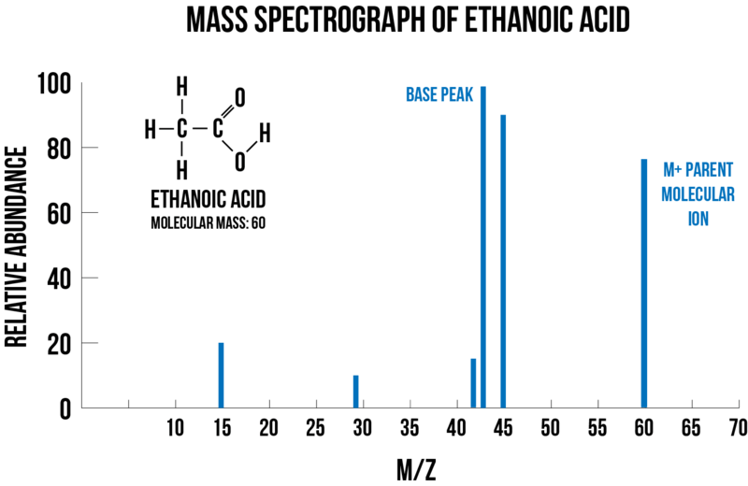
A mass spectrum is a plot of the relative abundance of the ions against their mass/charge ratio (m/z or m/e).
The tallest peak is called the base peak and is given an abundance of 100%. Everything else is measured relative to this. For example, in the mass spectrum of ethanoic acid below, the base peak is found at m/z=43.

Slide 7
The molecular parent ion is almost always the peak with the highest mass/charge ratio.
The molecular ion (M⁺) is the most important peak on the mass spectrum. This is the ion that has been formed by removing one electron from the target molecule.
Since electrons have a negligible mass compared to the mass of atoms or molecules, the mass of the molecular ion is practically the same as the mass of the molecule itself.

Slide 8
Molecular ions are unstable, so some of them will also break up into smaller fragments. The spectrum will therefore have peaks corresponding to various different fragments of the original molecule.
Using the mass difference between the peaks, we can identify the pieces that have fallen off the molecule.
The likelihood of a specific ion forming depends on the energy of the bond that must be broken as well as the stability of the fragment that forms.

Slide 9
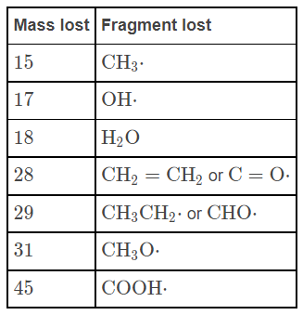
You need to be able to recognise the mass fragments shown below. You don't need to memorise the details, as they will be given to you, but you should be able to quickly recognise, for example, that a fragment of mass 15 corresponds to CH₃⁺​.
This is simply the sum of the relative atomic masses, for example CH₃​ = 12+(1×3)

Slide 10
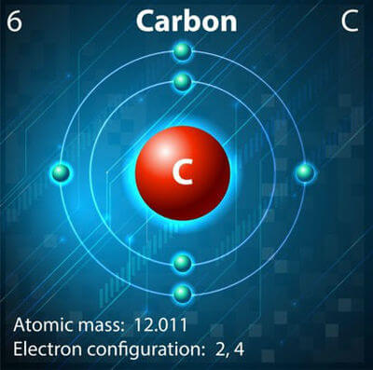
You can work out what the fragments are by looking at the mass of the elements that make them up. You will only see fragments with a charge of 1+ and therefore the m/z ratio corresponds to the mass of the fragment.
For example, CH_{3​} is made up of one carbon atom (M=12.01) and three hydrogen atoms (M=3×1.01). This gives a mass of 15.04, which corresponds to the m/z=15 fragment.
If you see a fragment with a mass that does not appear in the given table, simply look at the periodic table to try and work out how many of which atoms could be present in that fragment.

Slide 11

You may also be asked to work out the molecular formula of a compound from its empirical formula and mass spectrum.
For example, the empirical formula of a compound is C₂​H₄​O. The molecular ion peak in the mass spectrum appears at m/e=88.
What is the molecular formula of the compound?

Slide 12
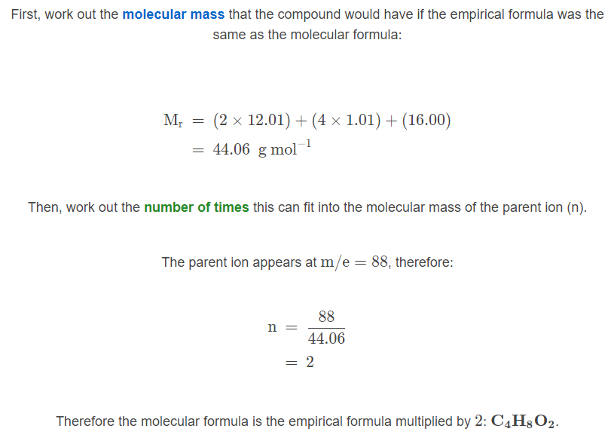

Slide 13

Electrically charged particles can be deflected by a magnetic field, but not neutral ones. Mass spectrometry utilises this principle. The steps are:
1. Ionisation
The atom or molecule is ionised by knocking one or more electrons off, forming a positive ion. Even things that would normally form negative ions or not form ions at all give positive ions in a mass spectrometer.

Slide 14
2. Acceleration
The ionised particles are accelerated into the deflector that contains the magnetic field.
3. Deflection
The magnetic field causes the ionised particles to be deflected towards the detector according to their mass and their charge. Lighter particles are deflected more than heavier particles. Ions with two or more positive charges are deflected more than ions with one positive charge. You will likely only encounter ions with a 1+ charge, but be aware that there can be 2+ ions formed also.

Slide 15
4. Detection
As each ion hits the detector, an electrical current is produced. This information is sent to the processor which produces a mass spectrum trace from the data.
The mass and charge on the ion are combined to form a mass/charge ratio (m/z or m/e). Ions that are the most deflected have the smallest mass/charge ratio.

Slide 16
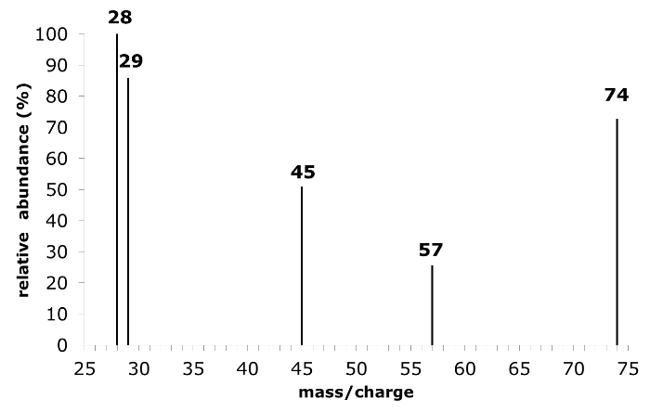
Can you work out the structure of the compound whose mass spectrum is shown below? The empirical formula of the compound is C₃​H₆​O_{2​}.

Slide 17
C₃​H₆​O_{2​}
The first step is to determine the molecular formula by comparing the empirical formula to the mass/charge of the molecular ion.
The molecular ion has m/z=74. The molar mass of C₃​H_{6​}O_{2​} is 74. Therefore the molecular formula is the same as the empirical formula.

Slide 18
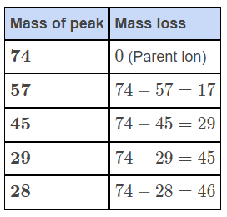
C_{3​}H₆​O_{2​}
Next, write down the mass of all the peaks you can see on the graph. Then, calculate the mass lost from each fragment compared to the mass of the parent ion.

Slide 19
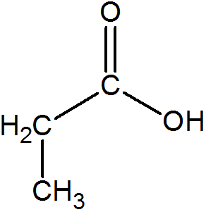
The structure that is consistent with this fragmentation pattern is propanoic acid:

